Slide 1
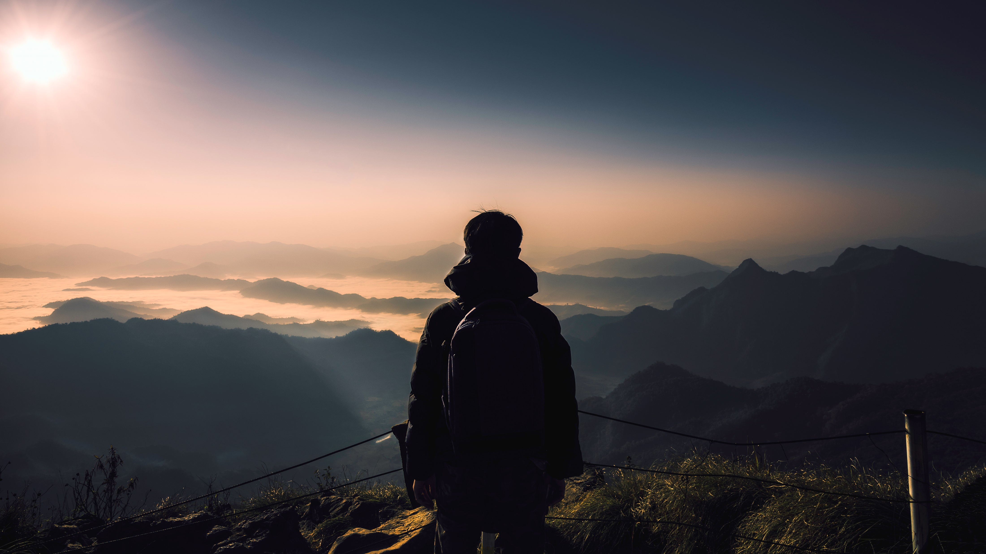
Boston travels
LOKESH CHALLAGULLA : 002921968
VENKATA SAIRAM MANDAPATI : 002768738
ARTHY SEKAR : 002769197
BALAJI ARUN SELVAN : 002769193
JAGITHYALA SMRITHI : 002658318

Slide 2

Table of content
DESCRIPTION
TECH STACK
USER
IMPLEMENTATION

Slide 3

Description
Boston Travels is a travel website, where users can book and explore different travel packages.
The website has user authentication which is login and signup.
The website includes webpages like:
Sign Up
Login Page
Home
Packages
About
Contact Us

Slide 4
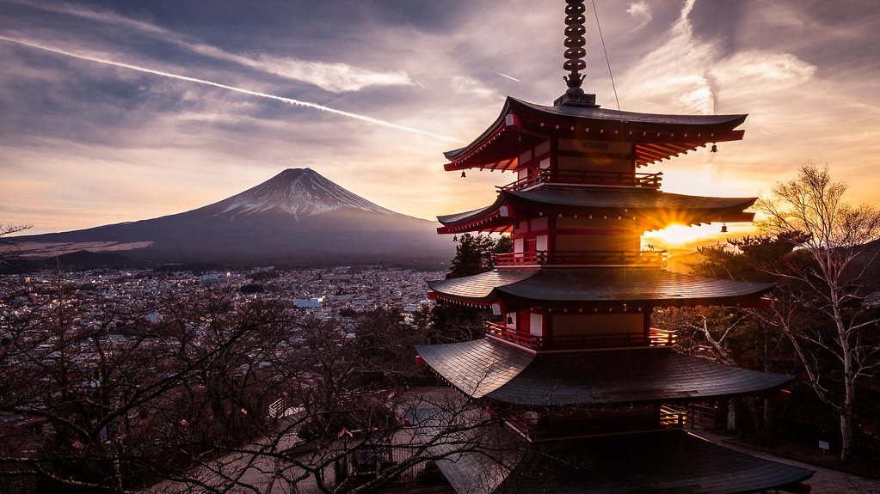
Tech Stack
MongoDB – For Database
Bootstrap – For Dynamic and responsive website
NodeJS, Express – For Backend Connection
CSS – For Styling
ReactJS, HTML, JavaScript – For Frontend
This Photo by Unknown author is licensed under CC BY.

Slide 5
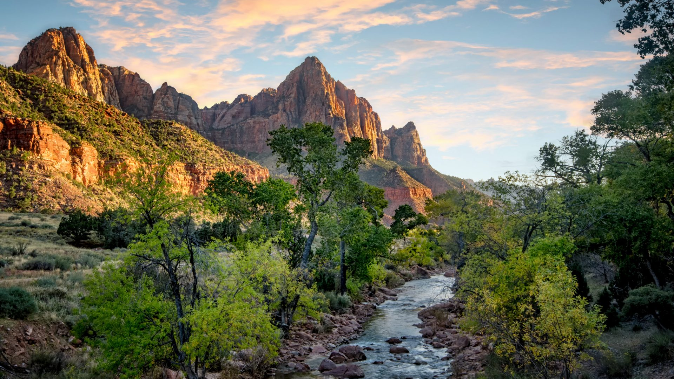
Users
Multiple users can sign up and login.
Users can explore different packages to choose from.
Users can find a suitable package according to their like.
Users can reach out using the Contact Us section in the website.
This Photo by Unknown author is licensed under CC BY-NC-ND.

Slide 6

Implementation
This Photo by Unknown author is licensed under CC BY-NC-ND.

Slide 7
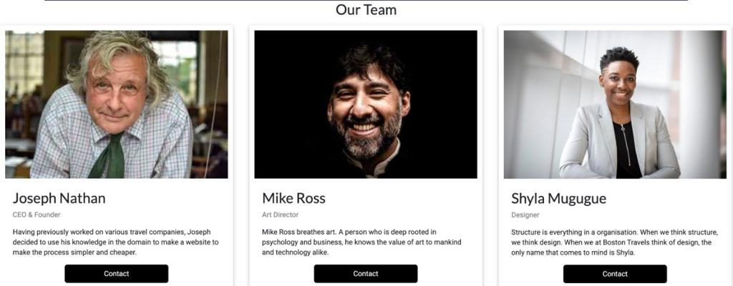
About page
This Photo by Unknown author is licensed under CC BY-NC-ND.

Slide 8
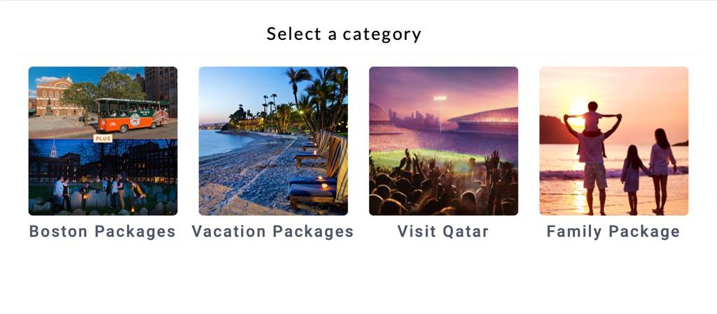
Packages
This Photo by Unknown author is licensed under CC BY-NC-ND.

Slide 9
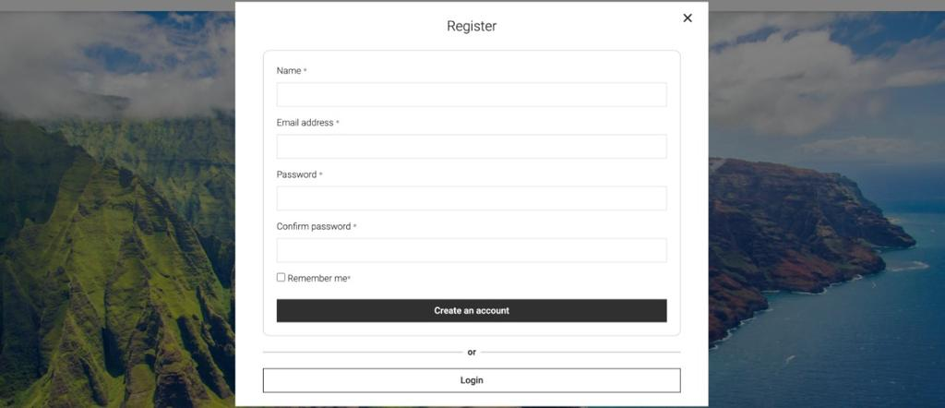
Register page
This Photo by Unknown author is licensed under CC BY-NC-ND.

Slide 10
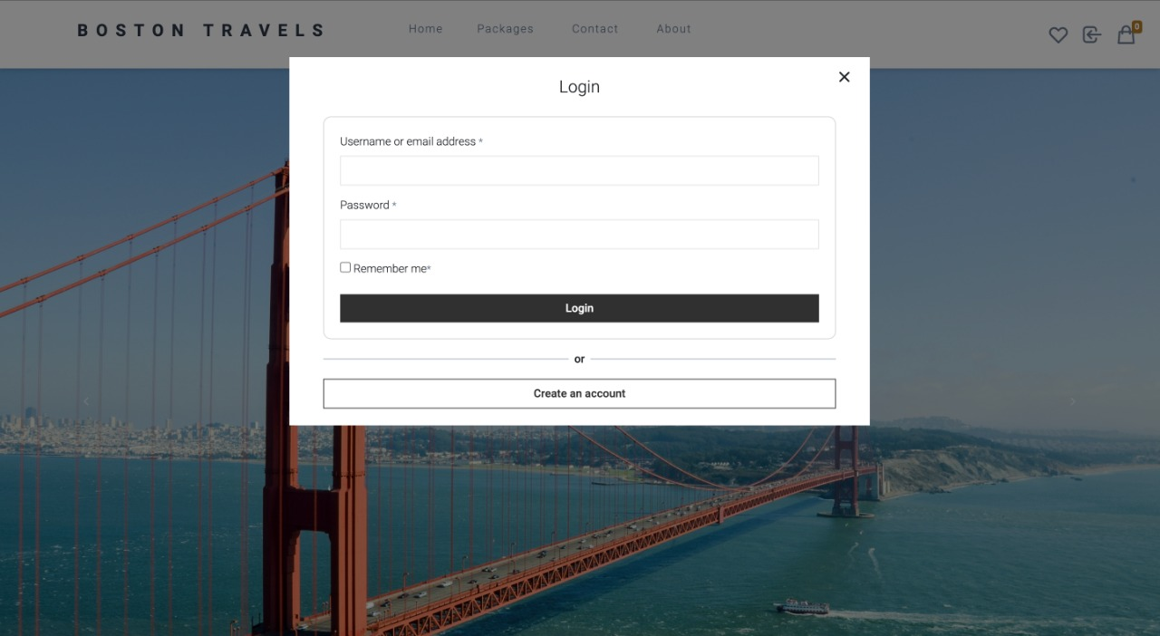
Login page
This Photo by Unknown author is licensed under CC BY-NC-ND.

Slide 11
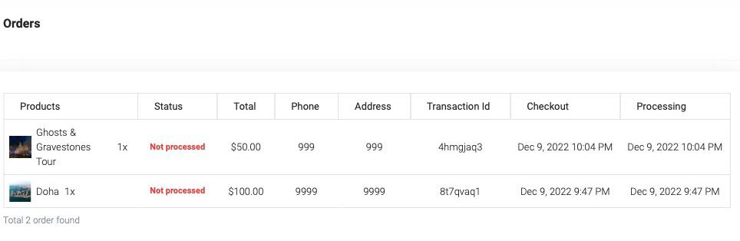
Orders
This Photo by Unknown author is licensed under CC BY-NC-ND.

Slide 12
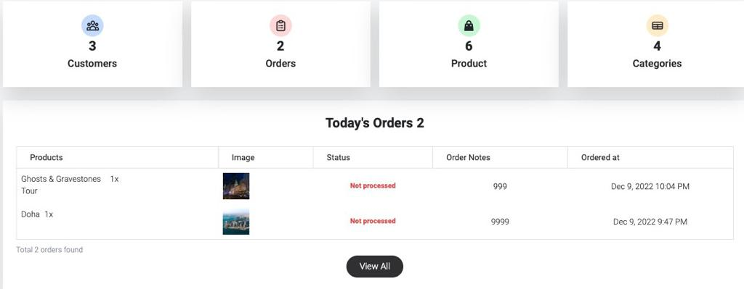
Admin PAge
This Photo by Unknown author is licensed under CC BY-NC-ND.

Slide 13
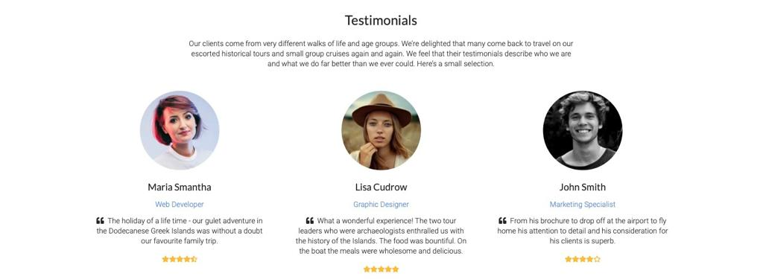
Testimonials
This Photo by Unknown author is licensed under CC BY-NC-ND.

Slide 14
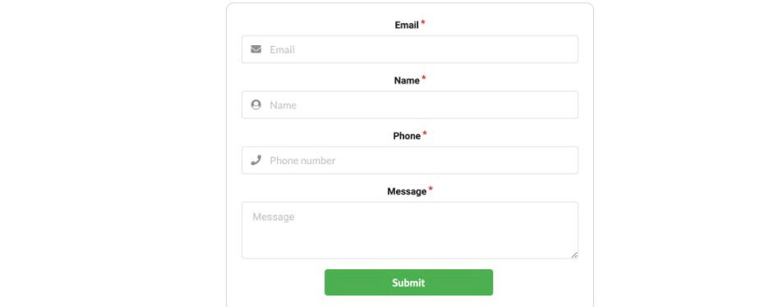
Contact page
This Photo by Unknown author is licensed under CC BY-NC-ND.

Slide 15
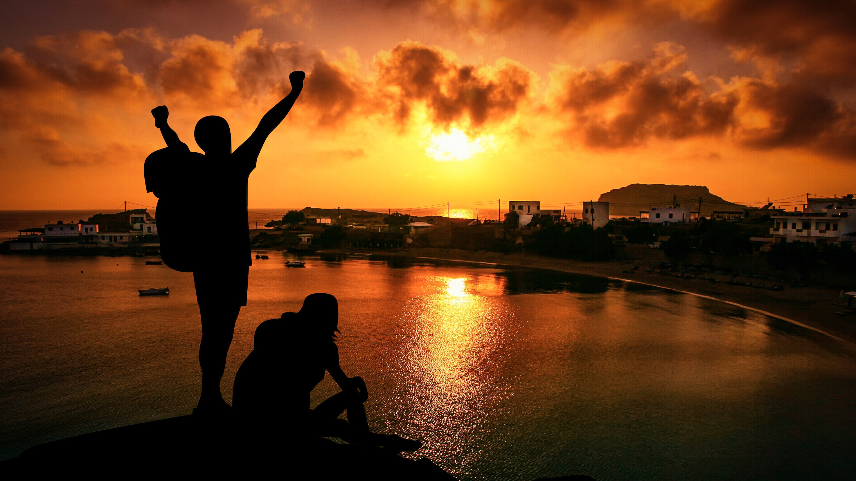
Thankyou

